Slide 1
Java Course Introduction
Università di Modena e Reggio Emilia
Prof. Nicola Bicocchi (nicola.bicocchi@unimore.it)

Slide 2
What?
Object-oriented programming (OOP) is a programming paradigm based on the concept of "objects", which can contain data and code: data in the form of fields (often known as attributes or properties), and code, in the form of procedures (often known as methods).

Slide 3
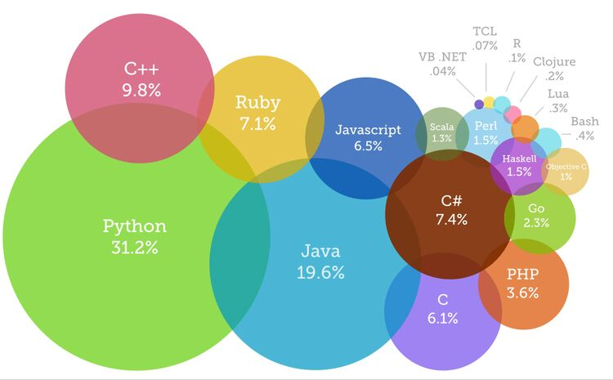
Why?
OOP followed Procedural Programming due to serious limitations affecting large-scale projects
OOP is the de facto standard for industrial software
Building modern applications almost always requires OOP languages such as Java, Python, C#, C++

Slide 4
How?
https://github.com/nbicocchi

Slide 5
When?

Slide 6
Exam?
Yes, there will be a final examination
Oral examination about OOP and the Java and Python languages (short written exercises might be used)
Discussion about the structure and engineering choices of a home project written in Java or Python (1000-5000 source lines of code)

